Slide 1
Python Primer

Slide 2
Jupyter Notebook
The Jupyter notebook is an open-source web application that allows you to create and share documents that contain live code, equations, visualizations and narrative text.
JupyterLab (https://jupyter.org/index.html)is a web-based interactive development environment for Jupyter notebooks, code, and data.
We will use Jupyter notebook with Anaconda (https://www.anaconda.com/),
Python suite of popular science, math, engineering, and data analysis
Supporting Python 3
Fully open source and free

Slide 3

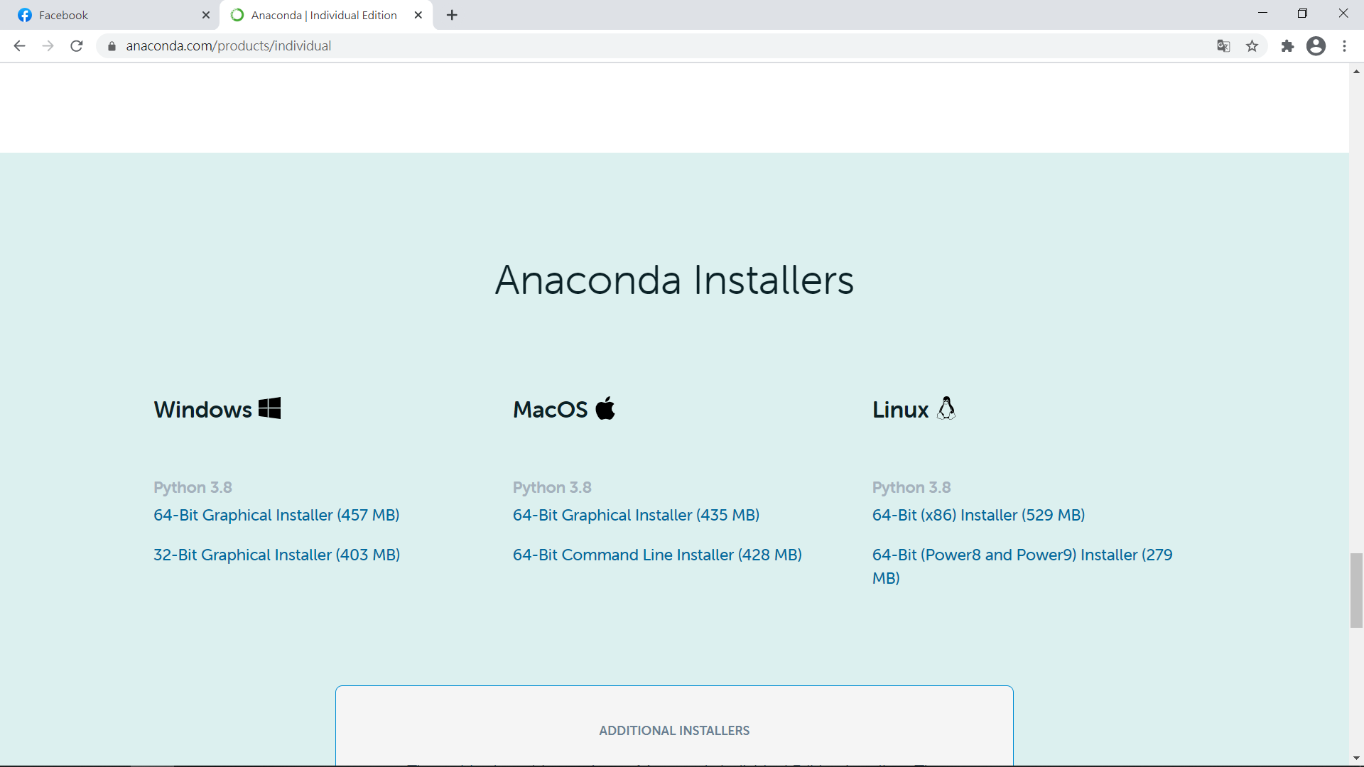

https://www.anaconda.com/products/individual
https://www.anaconda.com/

Slide 4


Installation
Using windows searching to search “Anaconda navigator” and open it.
This window shows all components of Anaconda

Slide 5
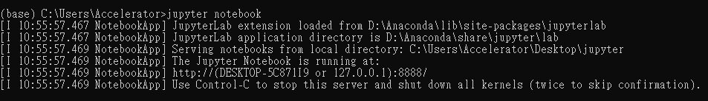
Running Jupyter notebook
Using windows searching search “Anaconda Prompt” and open it.
It is a cmd. for Anaconda only.
Enter command “jupyter notebook” to run Jupyter notebook service.

Slide 6
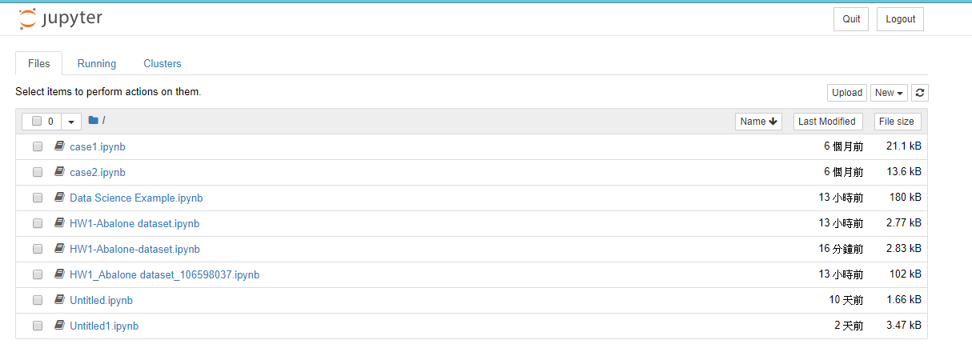
Jupyter Notebook Working Directory

Slide 7
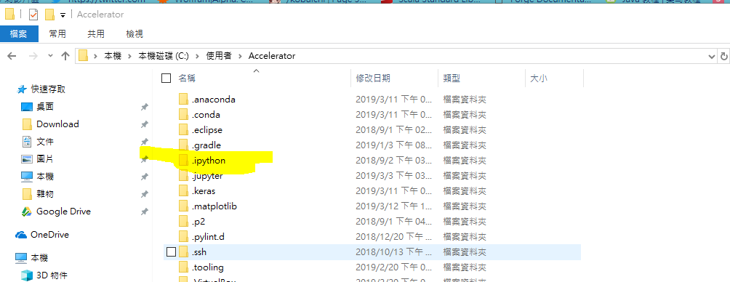
Jupyter Notebook Configuration
Control-C to shutdown the service.
Enter command “jupyter notebook --generate-config” and you will create the default config file at home folder.
The folder is hidden and its name is “.jupyter”.

Slide 8
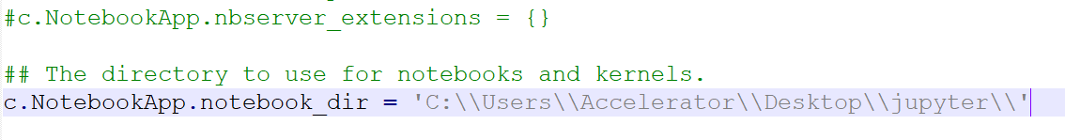
Jupyter Notebook Configuration
Create a workspace folder for jupyter.
Using any editor to open the file jupyter_notebook_config.py.
Find variable c.NotebookApp.notebook_dir and change its value to your workspace location.
Erase the hash tag and write the location (the Backslash need to change to double-Backslash)

Slide 9
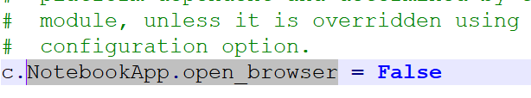
Jupyter Notebook Configuration
Find variable c.NotebookApp.open_browser and change to False.
Next time when you boot the Jupyter service, it will not open the website.

Slide 10
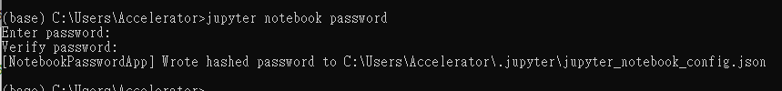
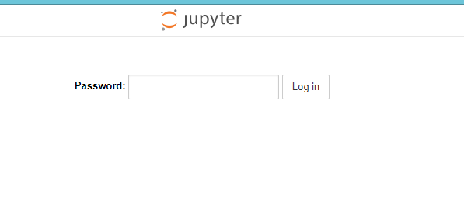
Jupyter Notebook
Back to the Anaconda Prompt, enter command “jupyter notebook password” to set a password.
Enter command “jupyter notebook”, open the service.
Open browser and open the https://localhost:8888

Slide 11
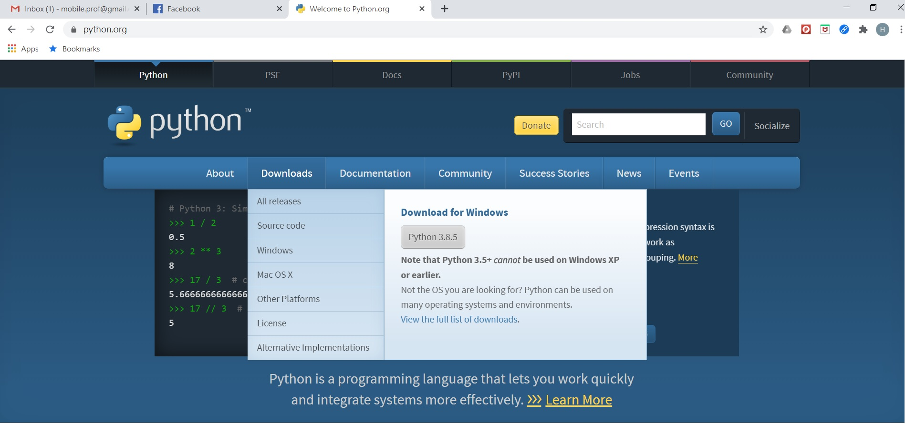
Python (Only) Installation
https://www.python.org/

Slide 12
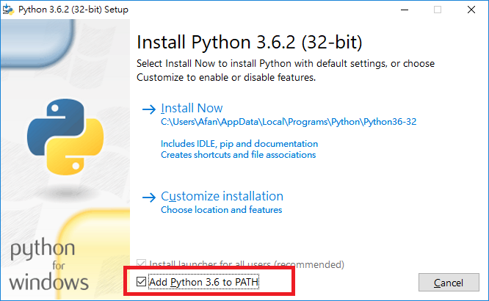
Using Python 3.6 as an Example

Slide 13
Python Interpreter
Python is an interpreted language
Python interpreter
A series of commands, known as source code or script, is stored in a text file named with the .py suffix, say hello.py.
Python interpreter can be started by typing python from the command line
an additional -i flag to execute and enter interactive mode

Slide 14
Python Program
Python’s syntax relies heavily on the use of whitespace
Individual statements are typically concluded with a newline character
Whitespace is also key in delimiting the bodies of control structures in Python
The primary syntax for comments in Python is based on use of the # character
A Python Script

Slide 15
Objects in Python
Python is an object-oriented language
Classes form the basis for all data types
Python’s built-in classes include:
int: integers,
float: floating-point values
str: character strings

Slide 16
Assignment Statement
assignment
height = 88.5
Identifier (name)
object (float)
identifier height references an instance of the float class having value 88.5
float
88.5
height

Slide 17
Identifiers
Identifiers in Python are case-sensitive
Can be almost any combination of letters, numerals, and underscore characters
Cannot begin with a numeral
Each identifier is implicitly associated with the memory address of the object to which it refers.
Reserved Words

Slide 18
Object Association
Python is a dynamically typed language
there is no advance declaration associating an identifier with a particular data type.
an identifier can be associated with any type of object, and it can later be reassigned to another object of the same (or different) type
An alias can be set by assigning a second identifier to an existing object
standard = height

Slide 19
Re-assignment
standard = height
float
standard
88.5
height
height = height + 3.3
float
float
91.8
height
88.5
standard

Slide 20
Instantiation
The process of creating a new instance of a class is known as instantiation.
invoke the constructor of a class
Example: if there were a class named Widget
w=Widget(), no parameter needed
w=Widget(a,b,c), parameters needed
Many of Python’s built-in classes support what is known as a literal form for designating new instances.
For example, t=98.6 results in the creation of a new instance of the float class

Slide 21
Calling Methods
Python supports
traditional functions;
one or more methods (member functions) in classes
to be respectively invoked with
syntax such as sorted(data)
a specific instance of a class using the dot (“.”) operator, for example data.sort( )
Types of method behaviors:
accessors: do not change the state of an object;
mutators or update methods: change the state of an object

Slide 22
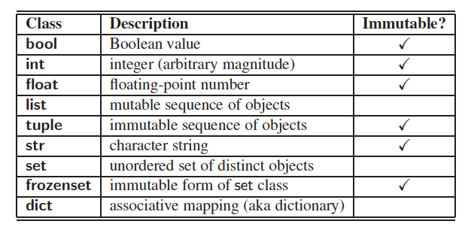
Python’s Built-In Classes
A class is immutable if each object of that class has a fixed value upon instantiation that cannot subsequently be changed.

Slide 23
The bool Class
The bool class is used for logical (Boolean) values, and the only two instances of that class are expressed as the literals:
True and False
The default constructor, bool( ), returns False.
Python allows the creation of a Boolean value from a nonboolean type using the syntax bool(foo) for value foo.
The interpretation depends upon the type of the parameter.
Numbers evaluate to False if zero, and True if nonzero.
Sequences and other container types, such as strings and lists, evaluate to False if empty and True if nonempty.

Slide 24
The int Class
The int class is designed to represent integers.
Python automatically chooses the internal representation for an integer based upon the magnitude of its value.
The integer constructor, int( ), returns 0 by default.
This constructor can
construct an integer value based upon an existing value of another type.
If f represents a floating-point value, the syntax int(f) produces the truncated value of f. For instance, int(3.14) produces the value 3, while int(−3.9) produces the value −3.
be used to parse a string that represents an integer.
Expression int(“137”) produces the integer value 137.

Slide 25
The float Class
The float class is the floating-point type in Python.
The floating-point of integer 2 can be expressed directly as 2.0.
One other form of literal for floating-point values uses scientific notation.
For example, the literal 6.022e23 represents the mathematical value 6.022×10²³.
The constructor float( ) returns 0.0.
When given a parameter, the constructor, float, returns the equivalent floating-point value.
float(2) returns the floating-point value 2.0
float(‘3.14’) returns 3.14

Slide 26
Sequence Types
Sequence types:
a collection of values where the order is significant.
list class is the most general, representing a sequence of arbitrary objects (akin to an “array” in other languages).
tuple class is an immutable version of the list class, benefiting from a streamlined internal representation.
str class is specially designed for representing an immutable sequence of text characters.

Slide 27
The list Class
A list is a referential structure, as it technically stores a sequence of references to its elements.
Elements of a list may be arbitrary objects (including the None object).
Lists are array-based sequences and are zero-indexed, thus a list of length n has elements indexed from 0 to n−1 inclusive.

Slide 28
The list Class
Python uses the characters [] as delimiters for a list literal
[] is an empty list
[’red’,’green’,’blue’] is a list of three strings
if identifiers a and b have been established, then syntax [a,b] is legitimate
The list() constructor
produces an empty list by default
accepts any parameter that is of an iterable type
list(‘hello’)
[‘h’,’e’,’l’,’l’,’o’]

Slide 29
The tuple Class
The tuple class provides an immutable version of a sequence
Python uses the parentheses to delimit a tuple, with () being an empty tuple

Slide 30
The str Class
Python’s str class is specifically designed to efficiently represent an immutable sequence of characters.
String literals can be enclosed in single quotes, as in ‘hello’, or double quotes, as in "hello".
Python also supports using the delimiter ’’’or """ to begin and end a string literal to embed newline characters naturally.

Slide 31
The set Class
Python’s set class represents a set, namely a collection of elements, without duplicates, and without an inherent order to those elements.
Only instances of immutable types can be added to a Python set.
Integers, floating-point numbers, and character strings are eligible to be elements of a set.
The frozenset class is an immutable form of the set type, itself.
Python uses curly braces { and } as delimiters for a set
For example, as {17} or {‘red’, ‘green’, ‘blue’}
The exception to this rule is that { } does not represent an empty set. Instead, the constructor set( ) returns an empty set.
If an iterable parameter is sent to the constructor, then the set of distinct elements is produced.
For example, set(“data”) produces {‘a’, ‘t’, ‘d’}

Slide 32
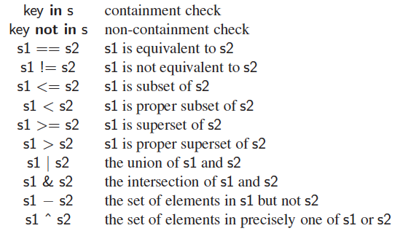
Operators for Sets
Sets and frozensets support the following operators:

Slide 33
The dict Class
Python’s dict class represents a dictionary, or mapping, from a set of distinct keys to associated values.
Python implements a dict using an almost identical approach to that of a set, but with storage of the associated values.
The literal form { } produces an empty dictionary.
A nonempty dictionary is expressed using a comma-separated series of key:value pairs.
Dictionary {‘ga’ : ‘Irish’, ‘de’ : ‘German’} maps ‘ga’ to ‘Irish’ and ‘de’ to ‘German’.
Alternatively, the constructor accepts a sequence of key-value pairs as a parameter, as in dict(pairs) with pairs = [(‘ga’, ‘Irish’), (‘de’, ‘German’)].

Slide 34
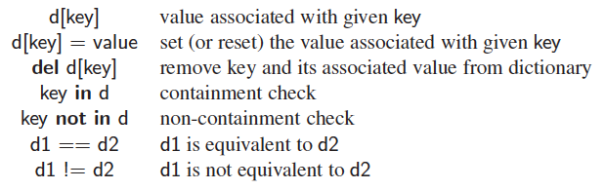
Operators for Dictionaries
The supported operators for objects of type dict are as follows:

Slide 35
Expressions and Operators
Existing values can be combined into expressions using special symbols and keywords known as operators.
The semantics of an operator depends upon the type of its operands.
when a and b are numbers, the syntax a + b indicates addition;
while if a and b are strings, the operator + indicates concatenation.

Slide 36

Logical Operators
Python supports the following keyword operators for Boolean values:
The and and or operators short-circuit,
Do not evaluate the second operand if the result can be determined based on the value of the first operand.

Slide 37
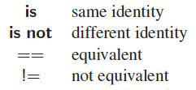
Equality Operators
Python supports the following operators to test two notions of equality:
The expression, a is b, evaluates to True, precisely when identifiers a and b are aliases for the same object.
The expression a == b tests a more general notion of equivalence.

Slide 38
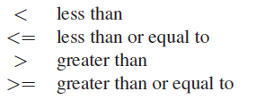
Comparison Operators
Data types may define a natural order via the following operators:
These operators
have expected behavior for numeric types, and
are defined lexicographically, and case-sensitively, for strings.

Slide 39
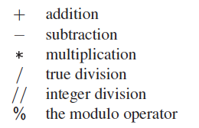
Arithmetic Operators
Python supports the following arithmetic operators:
For addition, subtraction, and multiplication, if both operands have type int, then the result is an int; if one or both operands have type float, the result is a float.
True division is always of type float, integer division is always int (with the result truncated)

Slide 40
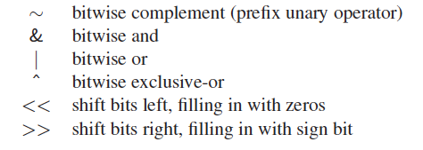
Bitwise Operators
Python provides the following bitwise operators for integers:

Slide 41
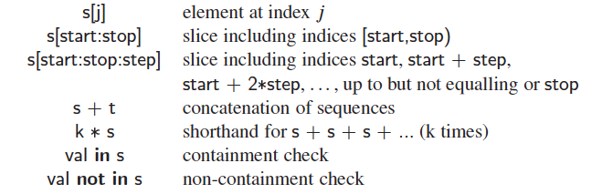
Sequence Operators
Each of Python’s built-in sequence types (str, tuple, and list) supports the following operator syntaxes:

Slide 42
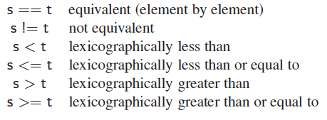
Sequence Comparisons
Sequences define comparison operations based on lexicographic order, performing an element by element comparison until the first difference is found.
For example, [5, 6, 9] < [5, 7] because of the entries at index 1.

Slide 43
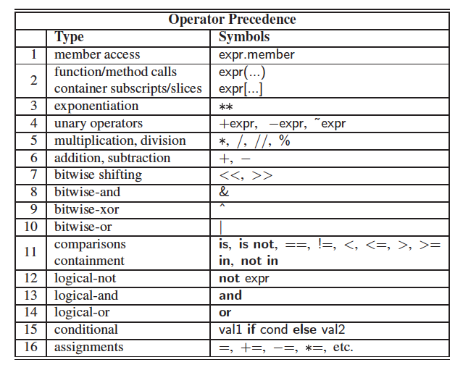
Operator Precedence

Slide 44
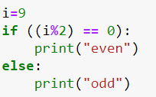
Control Flow – Conditionals

Slide 45
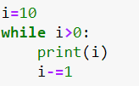
Control Flow – While Loops

Slide 46

Control Flow – For Loops
The for-loop syntax can be used on any type of iterable structure, such as list, tuple str, set, dict, or file …
range()function Syntax:
range(start, stop, step)
https://www.w3schools.com/python/ref_func_range.asp

Slide 47
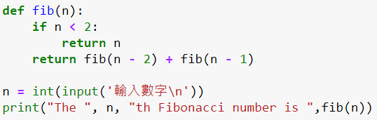
Functions
functions vs. methods
The first line, beginning with the keyword def, serves as the function’s signature

Slide 48
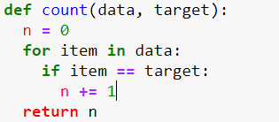
Information Passing
In the context of a function signature,
formal parameters: identifiers used to describe the expected parameters
actual parameters: objects sent by the caller when invoking the function
prizes = count(grades, 'A' )
data = grades
target = 'A'
grades
data
target
list
str
…
‘A’

Slide 49

Mutable Parameters
The formal parameter is an alias for the actual parameter
body of the function may interact with the object in ways that change its state
Note that: reassigning a new value to a formal parameter in function
does not alter the actual parameter
simply breaks the alias

Slide 50
The print Function
The built-in function, print,
is used to generate standard output to the console
prints an arbitrary sequence of arguments, separated by spaces, and followed by a trailing newline character
Example: print(‘maroon’,5)outputs the string ‘maroon 5\n’

Slide 51
The input Function
This function displays a prompt, if given as an optional parameter, and then waits until the user enters some sequence of characters followed by the return key.
When reading a numeric value from the user, a programmer must use the input function to get the string of characters, and then use the int or float syntax to construct the numeric value that character string represents.

Slide 52
Iterators and Generators
Iterations
Iterator: object manages an iteration through a series of values
Iterable: object produces an iterator
Generators
most convenient technique for creating iterators in Python
implemented with a syntax similar to a function, but instead of returning values, a yield statement is executed to indicate each element of the series.

